Slide 1

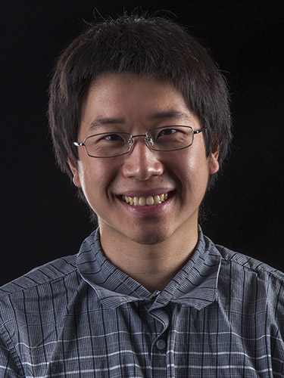

Adaptive Sketches for Robust Regression with Importance Sampling
Sepideh Mahabadi
David P. Woodruff
Samson Zhou

Slide 2




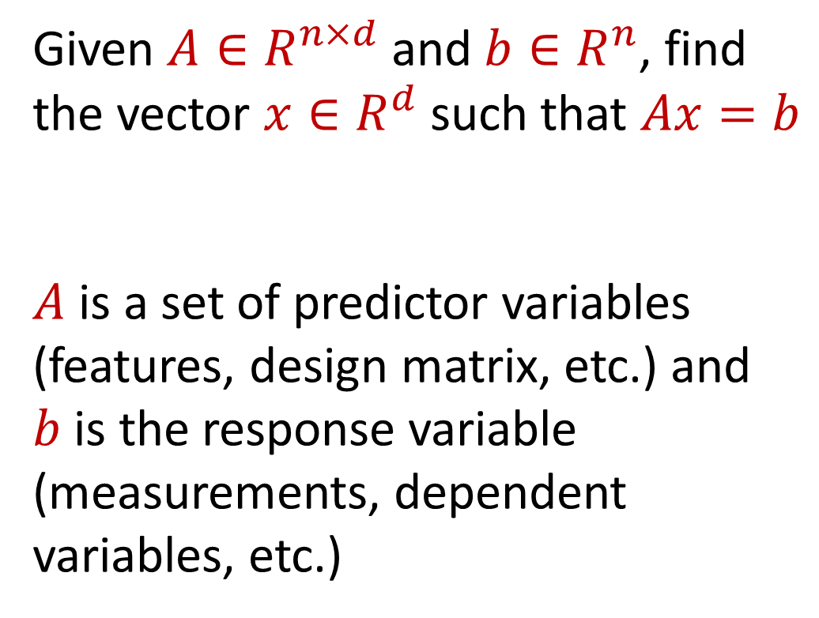






Regression
Given $A∈R^{n×d}$ and $b∈R^{n}$, find the vector $x∈R^{d}$ such that $Ax=b$
$A$ is a set of predictor variables (features, design matrix, etc.) and $b$ is the response variable (measurements, dependent variables, etc.)
$$d$$
$$x$$
$$≈$$
$$n$$
$$A$$
$$n$$
$$b$$
$$1$$
$$d$$
$$1$$

Slide 3
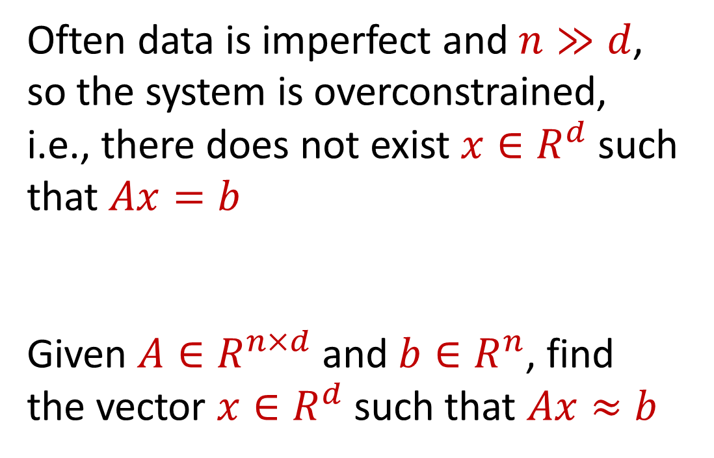

Regression
Often data is imperfect and $n≫d$, so the system is overconstrained, i.e., there does not exist $x∈R^{d}$ such that $Ax=b$
Given $A∈R^{n×d}$ and $b∈R^{n}$, find the vector $x∈R^{d}$ such that $Ax≈b$
$$d$$
$$x$$
$$≈$$
$$n$$
$$A$$
$$n$$
$$b$$
$$1$$
$$d$$
$$1$$

Slide 4
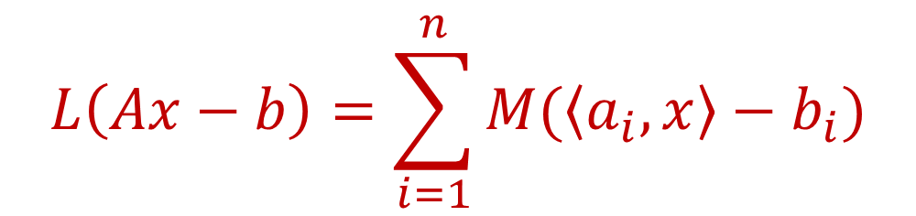

Regression
Given $A∈R^{n×d}$, $b∈R^{n}$, and a loss function $L$, find a vector $x∈R^{d}$ that minimizes $L(Ax−b)$, where
for some “measure” function $M$
$$d$$
$$x$$
$$≈$$
$$n$$
$$A$$
$$n$$
$$b$$
$$1$$
$$L\left(Ax−b\right)=\sum_{i=1}^{n}{M(\left\langle a_{i},x\right\rangle −b_{i})}$$
$$d$$
$$1$$

Slide 5
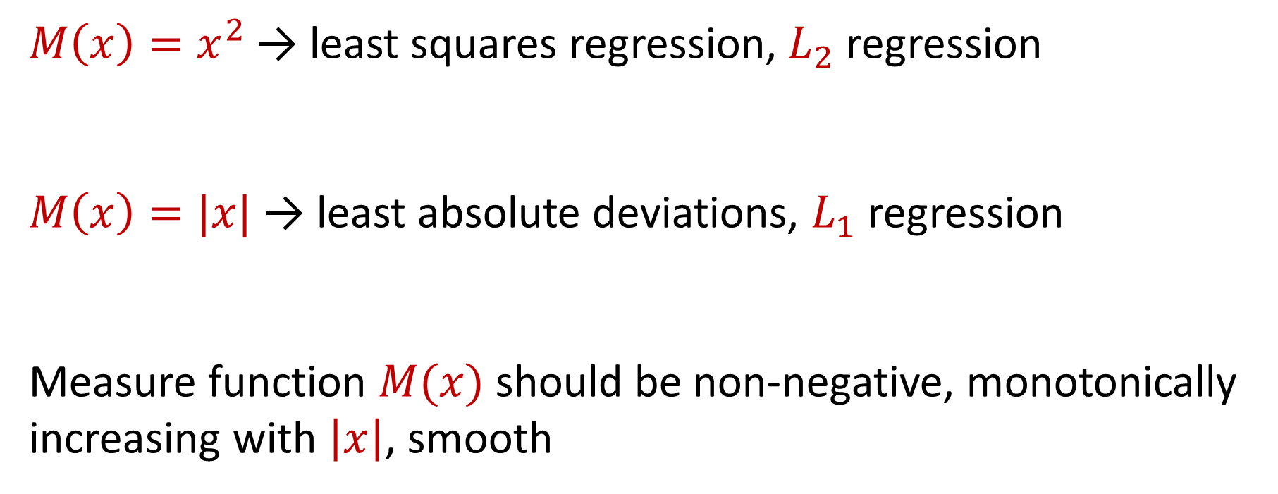
Measure Functions
$M\left(x\right)=x^{2}$→ least squares regression, $L_{2}$ regression
$M\left(x\right)=|x|$→ least absolute deviations, $L_{1}$ regression
Measure function $M(x)$should be non-negative, monotonically increasing with $\left|x\right|$, smooth

Slide 6

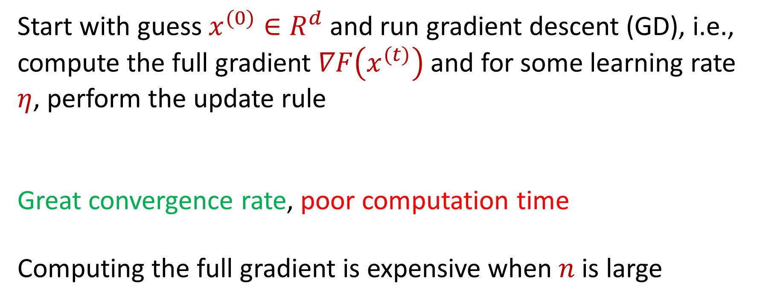
Approximate Regression via Gradient Descent
Start with guess $x^{(0)}∈R^{d}$ and run gradient descent (GD), i.e., compute the full gradient $∇F\left(x^{(t)}\right)$ and for some learning rate $η$, perform the update rule
Great convergence rate, poor computation time
Computing the full gradient is expensive when $n$is large
$$x^{(t+1)}=x^{(t)}+η∇F\left(x^{(t)}\right)$$

Slide 7
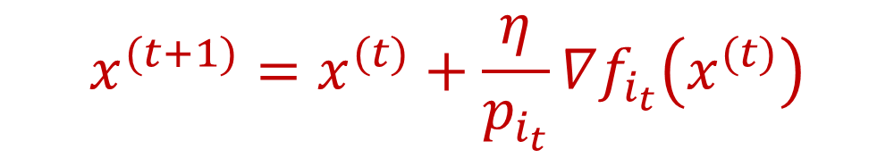
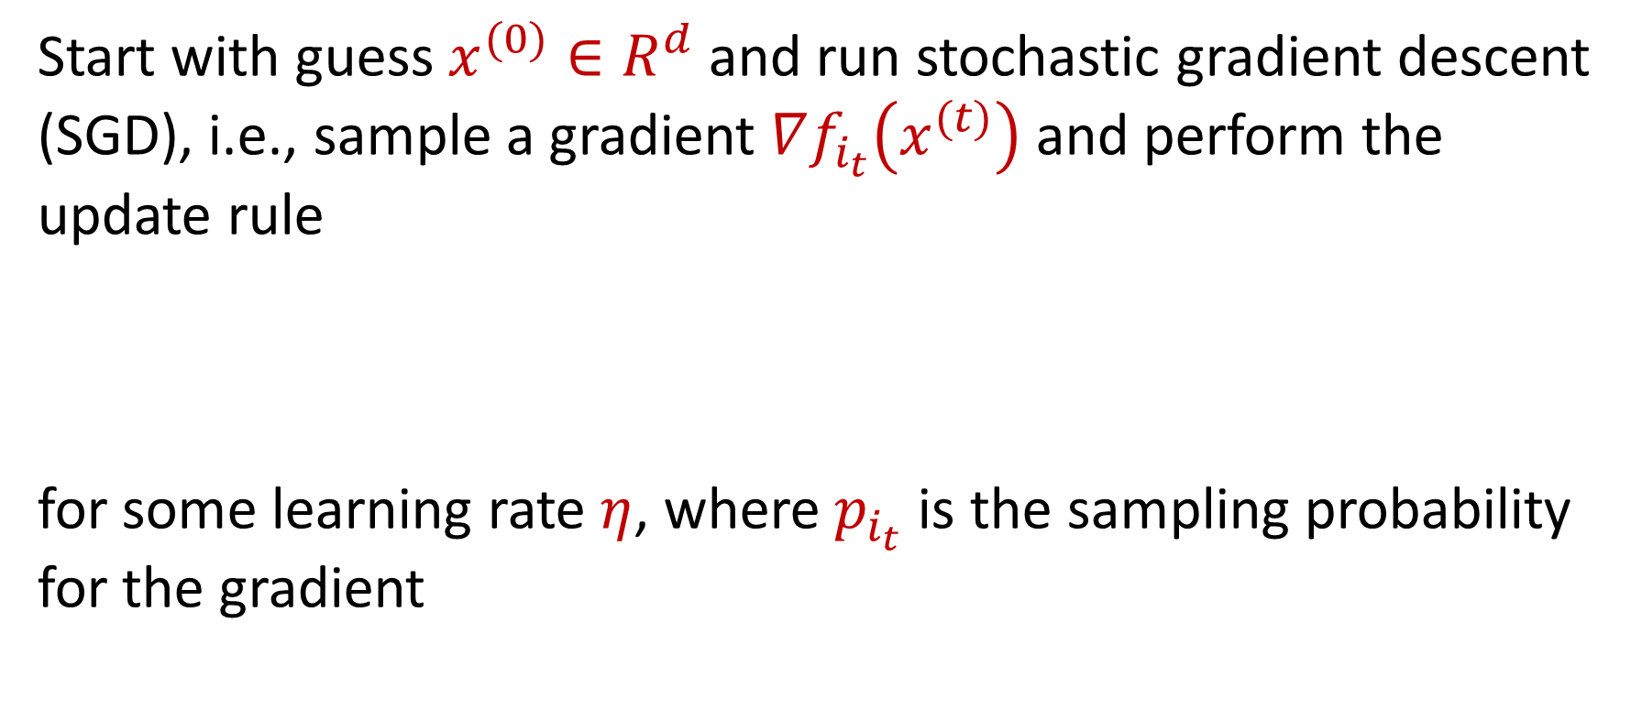
Approximate Regression via SGD
Start with guess $x^{(0)}∈R^{d}$ and run stochastic gradient descent (SGD), i.e., sample a gradient $∇f_{i_{t}}\left(x^{(t)}\right)$ and perform the update rule
for some learning rate $η$, where $p_{i_{t}}$ is the sampling probability for the gradient
$$x^{(t+1)}=x^{(t)}+\frac{η}{p_{i_{t}}}∇f_{i_{t}}\left(x^{(t)}\right)$$

Slide 8
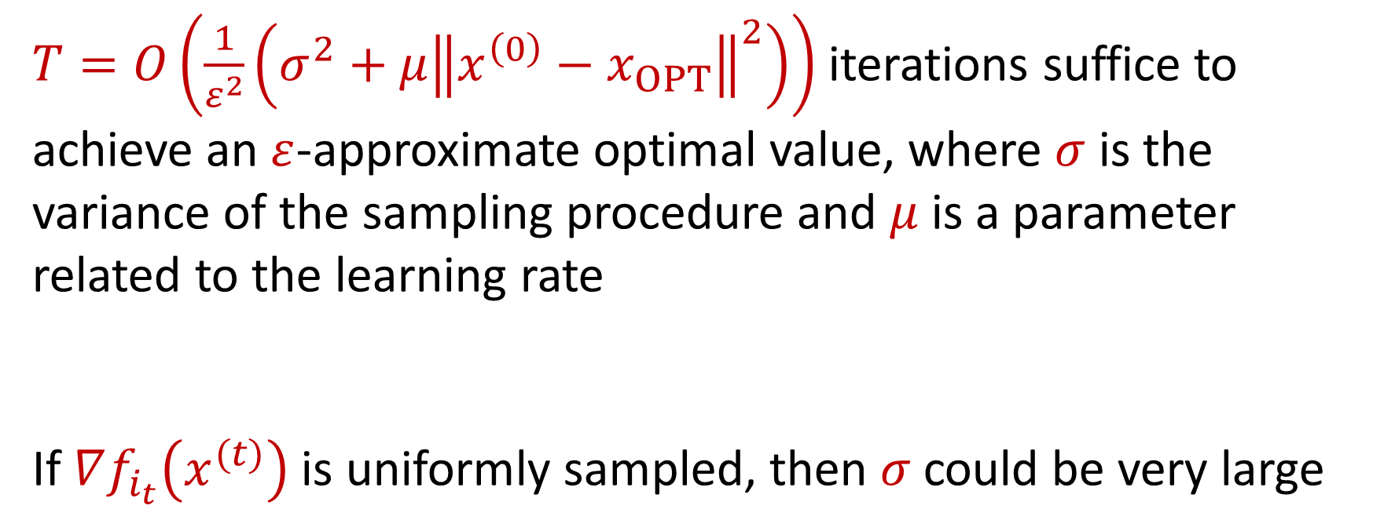
Convergence of SGD
$T=O\left(\frac{1}{ε^{2}}\left(σ^{2}+μ{\left\|x^{\left(0\right)}−x_{OPT}\right\|}^{2}\right)\right)$ iterations suffice to achieve an $ε$-approximate optimal value, where $σ$ is the variance of the sampling procedure and $μ$ is a parameter related to the learning rate
If $∇f_{i_{t}}\left(x^{(t)}\right)$ is uniformly sampled, then $σ$could be very large

Slide 9

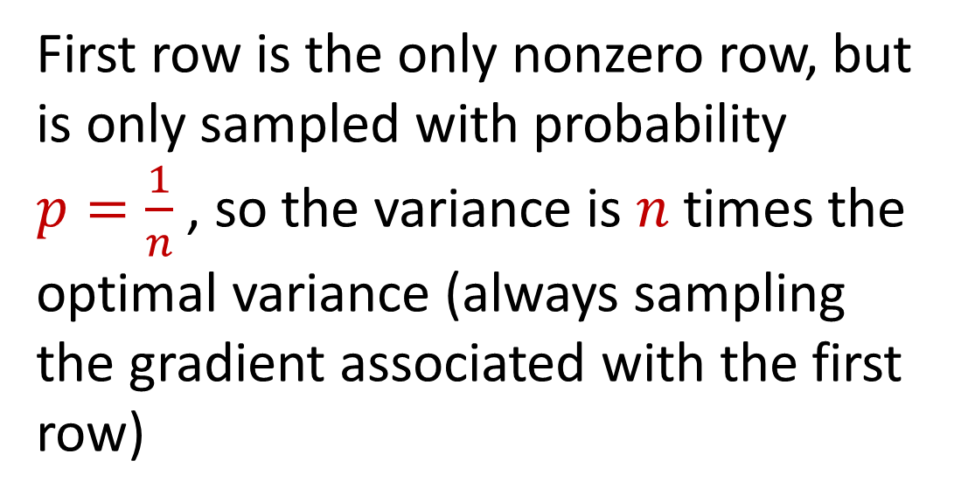

Convergence of SGD
1 3 5 -2 7 0 11 4 -8
0 0 0 0 0 0 0 0 0
0 0 0 0 0 0 0 0 0
0 0 0 0 0 0 0 0 0
0 0 0 0 0 0 0 0 0
0 0 0 0 0 0 0 0 0
0 0 0 0 0 0 0 0 0
0 0 0 0 0 0 0 0 0
First row is the only nonzero row, but is only sampled with probability $p=\frac{1}{n}$ , so the variance is $n$ times the optimal variance (always sampling the gradient associated with the first row)
$$n$$
$$d$$
Notes:
Although there’s a number of different streaming update models, in this talk we’ll focus on the row arrival model, where we gets rows of a matrix one at a time.

Slide 10
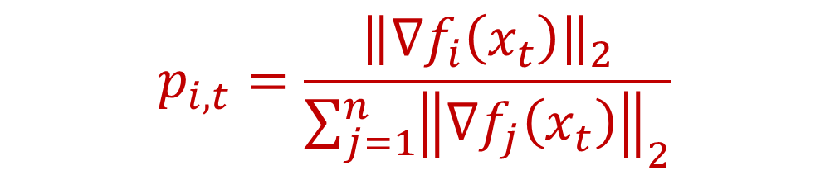
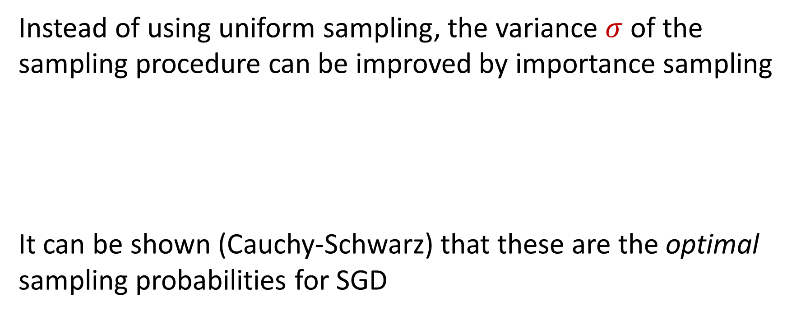
Importance Sampling
Instead of using uniform sampling, the variance $σ$ of the sampling procedure can be improved by importance sampling
It can be shown (Cauchy-Schwarz) that these are the optimal sampling probabilities for SGD
$$p_{i,t}=\frac{{\left\|∇f_{i}\left(x_{t}\right)\right\|}_{2}}{\sum_{j=1}^{n}{{\left\|∇f_{j}\left(x_{t}\right)\right\|}_{2}}}$$

Slide 11
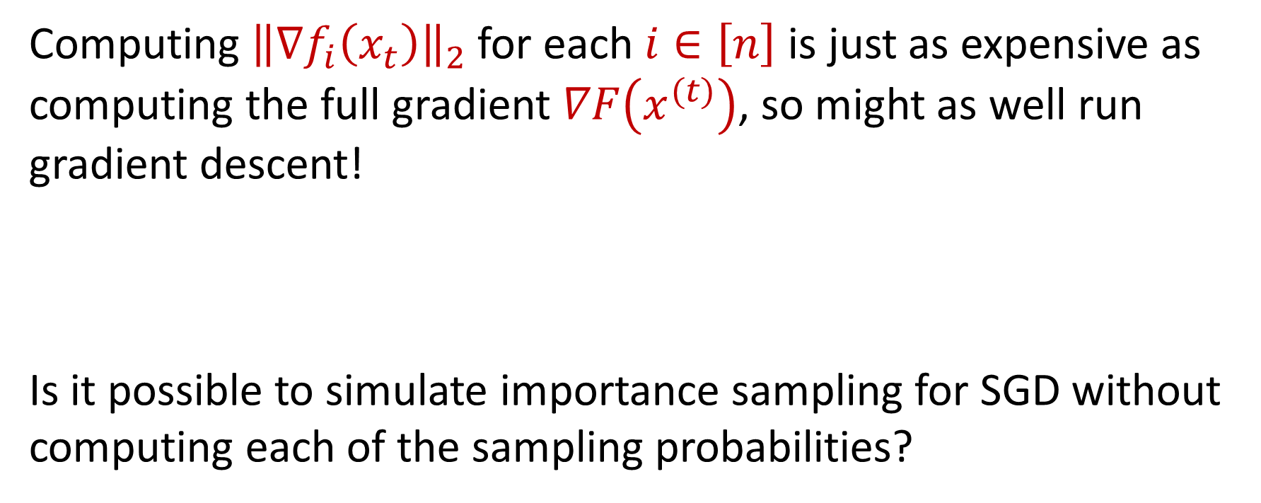
Chicken-and-Egg Problem
Computing ${\left\|∇f_{i}\left(x_{t}\right)\right\|}_{2}$ for each $i∈\left[n\right]$ is just as expensive as computing the full gradient $∇F\left(x^{(t)}\right)$, so might as well run gradient descent!
Is it possible to simulate importance sampling for SGD without computing each of the sampling probabilities?

Slide 12
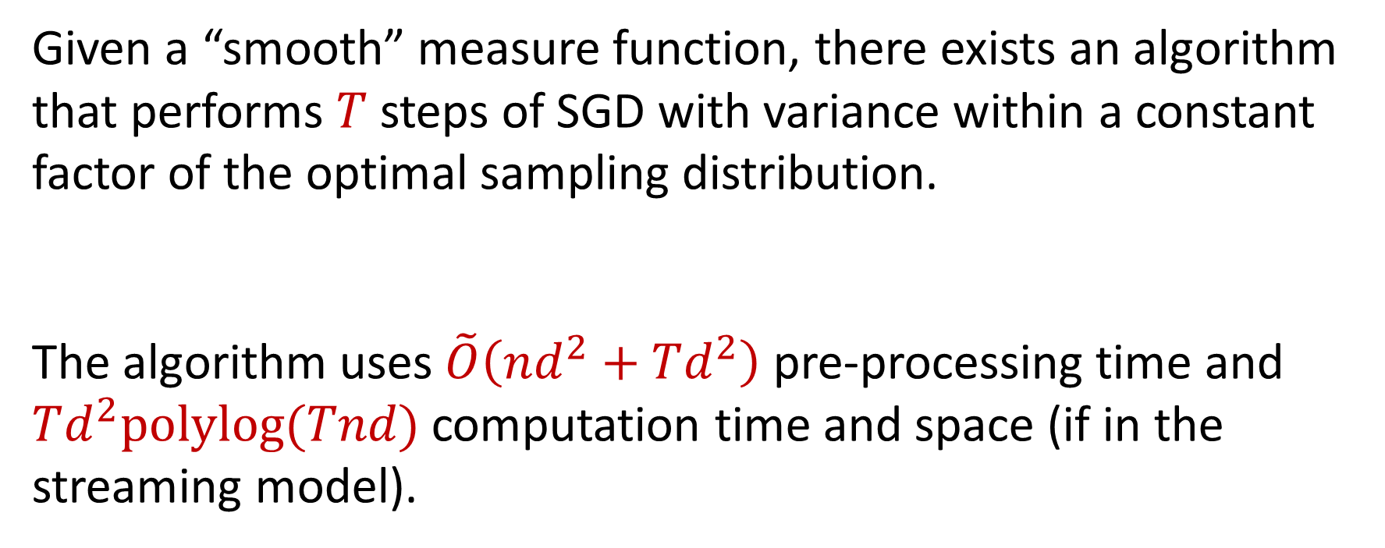
Our Result
Given a “smooth” measure function, there exists an algorithm that performs $T$ steps of SGD with variance within a constant factor of the optimal sampling distribution.
The algorithm uses $\tilde{O}\left(nd^{2}+Td^{2}\right)$ pre-processing time and $Td^{2}polylog(Tnd)$ computation time and space (if in the streaming model).

Slide 13
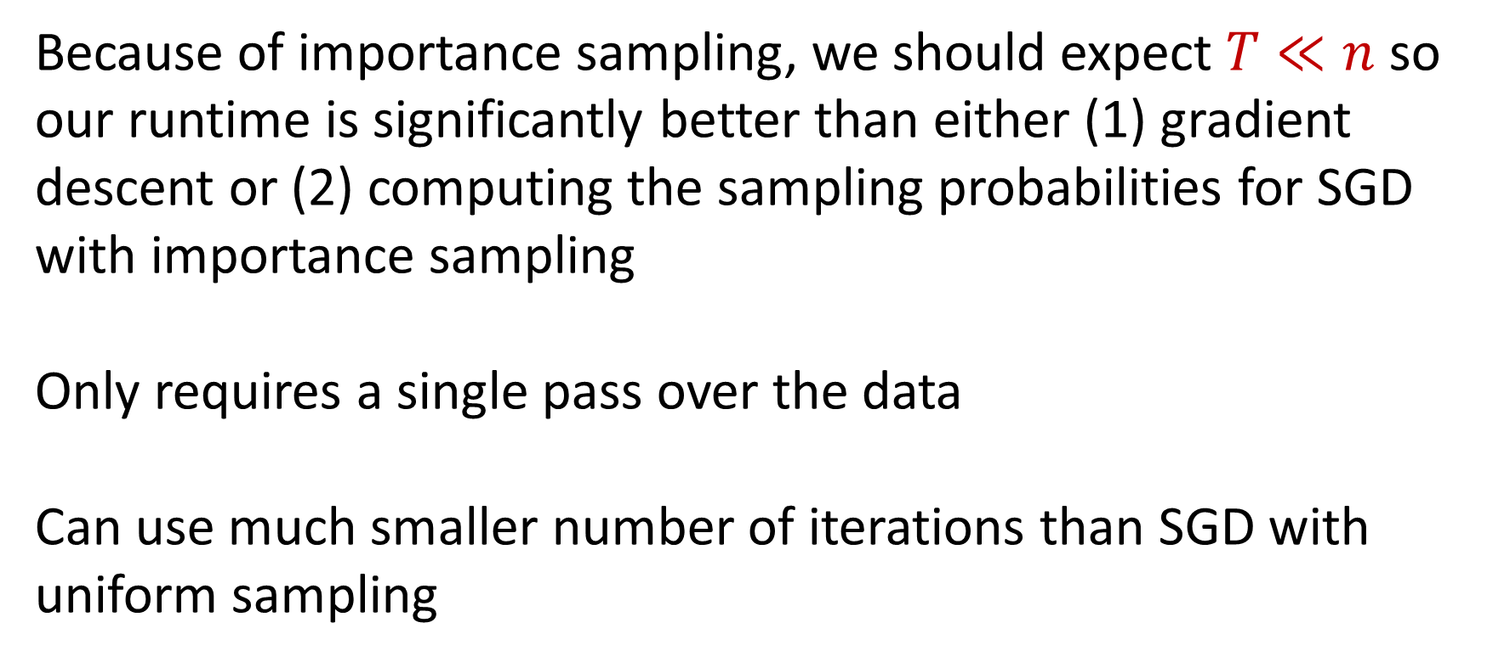
Context
Because of importance sampling, we should expect $T≪n$ so our runtime is significantly better than either (1) gradient descent or (2) computing the sampling probabilities for SGD with importance sampling
Only requires a single pass over the data
Can use much smaller number of iterations than SGD with uniform sampling

Slide 14
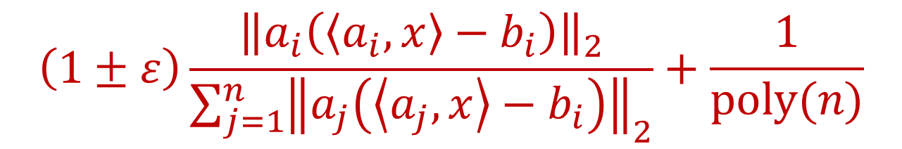
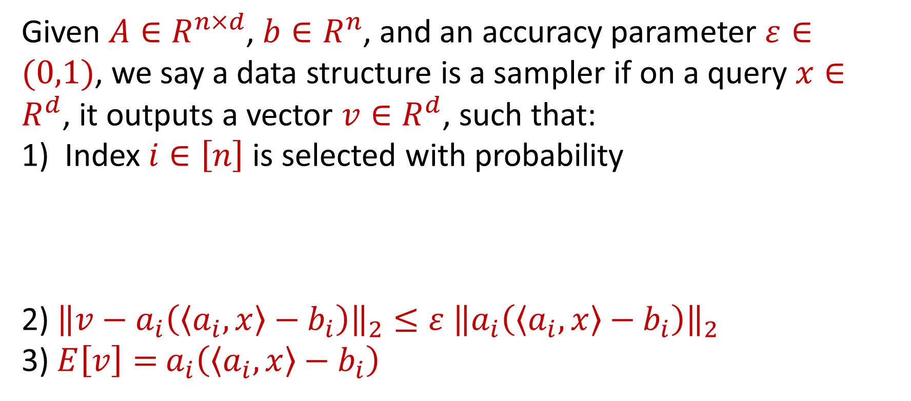
Ingredient #1: Sampler
Given $A∈R^{n×d}$, $b∈R^{n}$, and an accuracy parameter $ε∈(0,1)$, we say a data structure is a sampler if on a query $x∈R^{d}$, it outputs a vector $v∈R^{d}$, such that:
Index $i∈\left[n\right]$ is selected with probability
2) ${\left\|v−a_{i}\left(\left\langle a_{i}, x\right\rangle −b_{i}\right)\right\|}_{2}≤ε$ ${\left\|a_{i}\left(\left\langle a_{i}, x\right\rangle −b_{i}\right)\right\|}_{2}$
3) $E\left[v\right]=$ $a_{i}\left(\left\langle a_{i}, x\right\rangle −b_{i}\right)$
$$\left(1±ε\right)\frac{{\left\|a_{i}\left(\left\langle a_{i}, x\right\rangle −b_{i}\right)\right\|}_{2}}{\sum_{j=1}^{n}{{\left\|a_{j}\left(\left\langle a_{j}, x\right\rangle −b_{i}\right)\right\|}_{2}}}+\frac{1}{poly(n)}$$

Slide 15
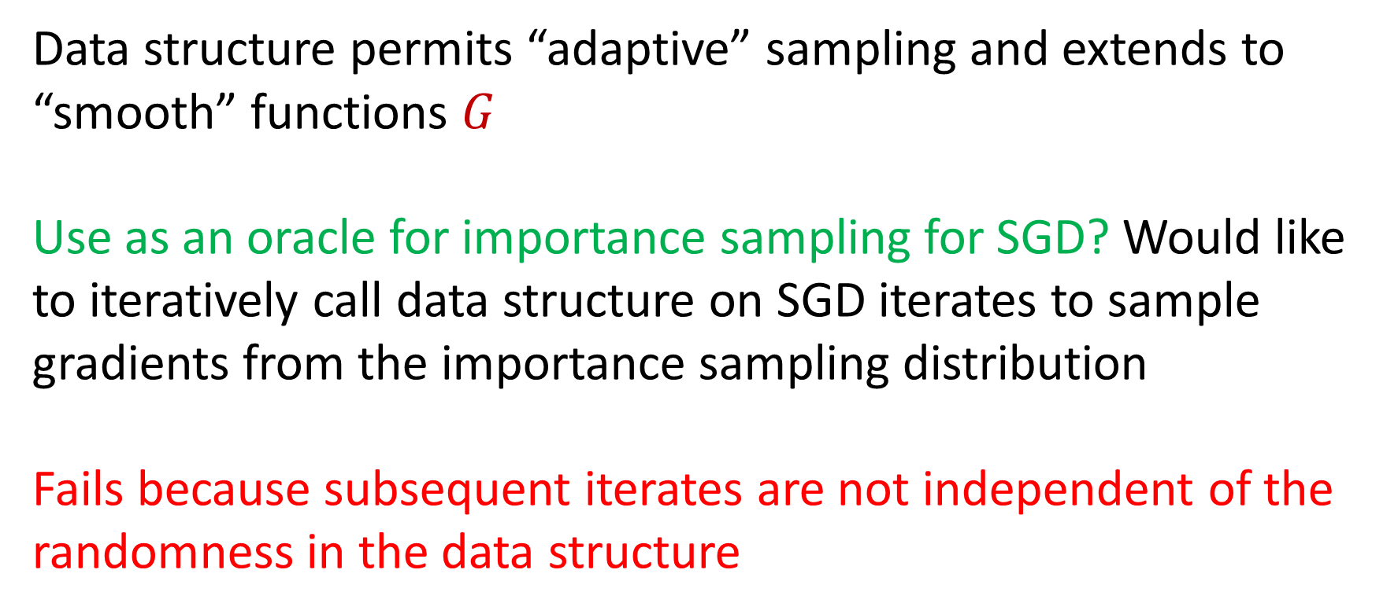
Ingredient #1: Sampler
Data structure permits “adaptive” sampling and extends to “smooth” functions $G$
Use as an oracle for importance sampling for SGD? Would like to iteratively call data structure on SGD iterates to sample gradients from the importance sampling distribution
Fails because subsequent iterates are not independent of the randomness in the data structure

Slide 16
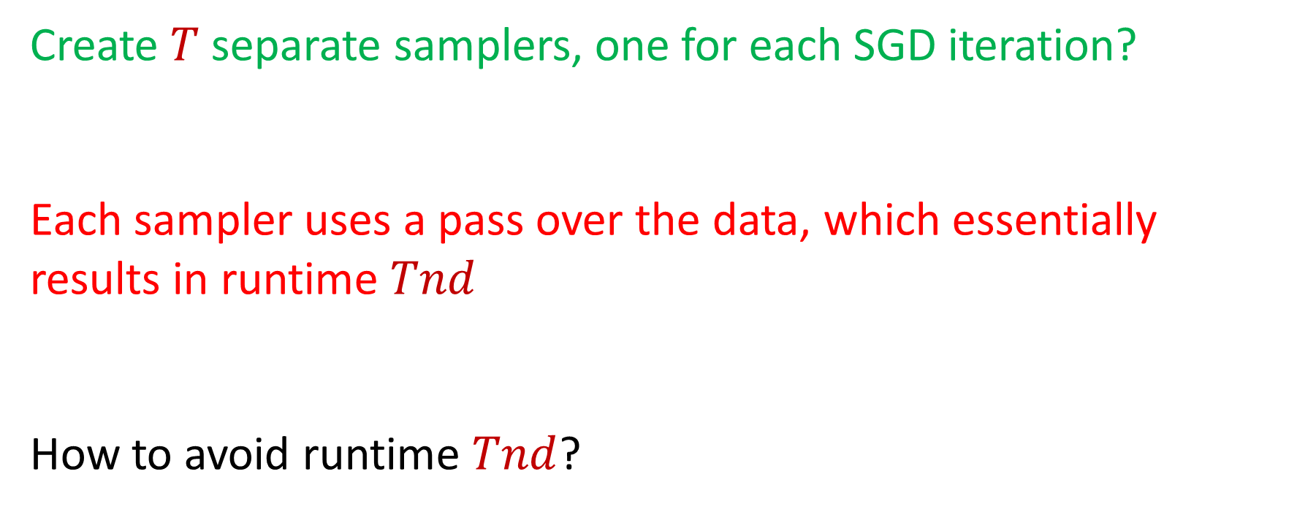
Ingredient #1: Sampler
Create $T$ separate samplers, one for each SGD iteration?
Each sampler uses a pass over the data, which essentially results in runtime $Tnd$
How to avoid runtime $Tnd$?

Slide 17
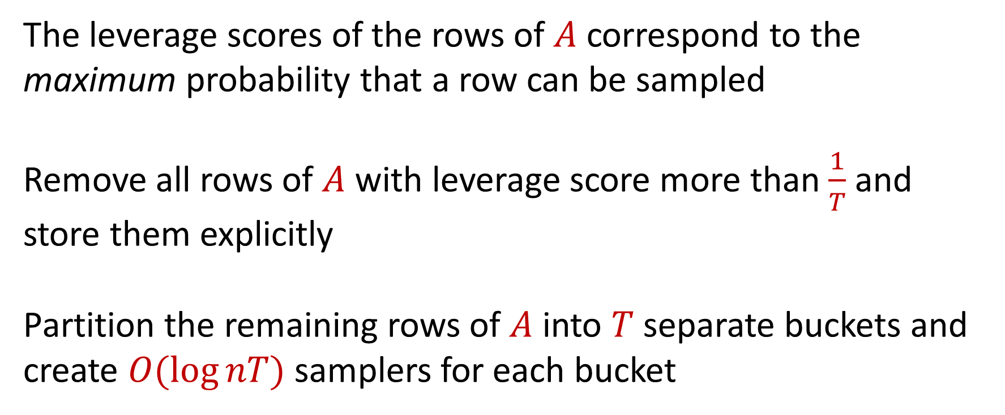
Ingredient #2: Bucketing for SGD
The leverage scores of the rows of $A$ correspond to the maximum probability that a row can be sampled
Remove all rows of $A$ with leverage score more than $\frac{1}{T}$ and store them explicitly
Partition the remaining rows of $A$ into $T$separate buckets and create $O(\log{nT})$ samplers for each bucket

Slide 18
Ingredient #2: Bucketing for SGD

Slide 19
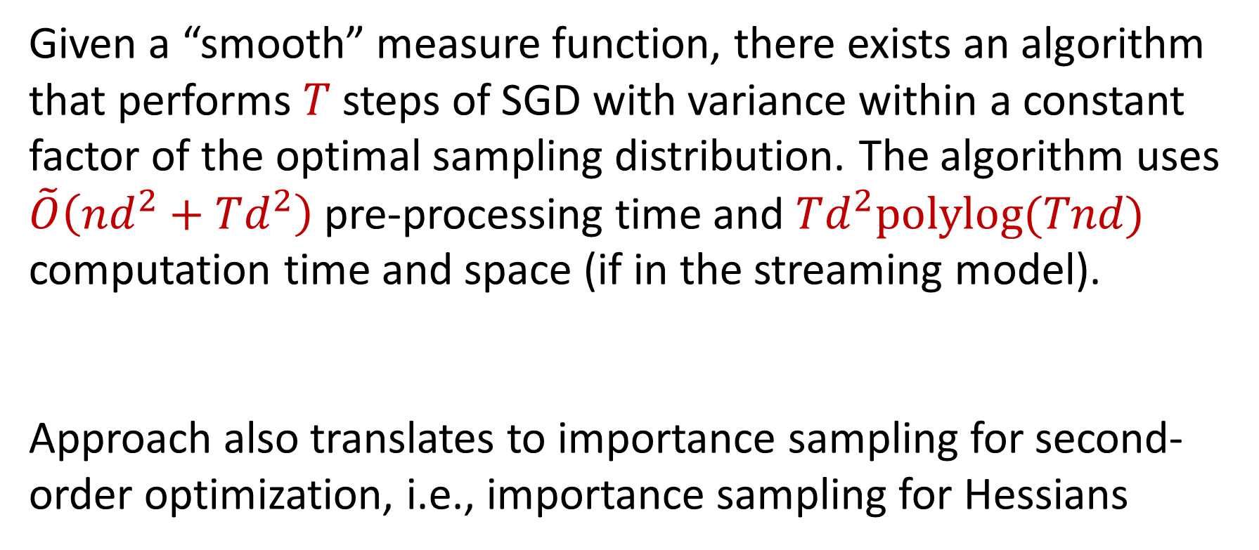
Summary
Given a “smooth” measure function, there exists an algorithm that performs $T$ steps of SGD with variance within a constant factor of the optimal sampling distribution. The algorithm uses $\tilde{O}\left(nd^{2}+Td^{2}\right)$ pre-processing time and $Td^{2}polylog(Tnd)$ computation time and space (if in the streaming model).
Approach also translates to importance sampling for second-order optimization, i.e., importance sampling for Hessians

Slide 20
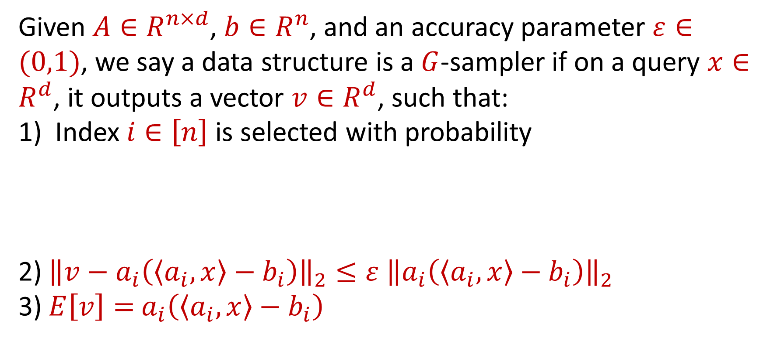
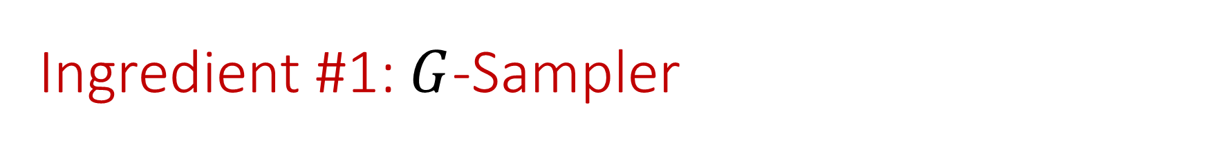
Ingredient #1: $G$-Sampler
Given $A∈R^{n×d}$, $b∈R^{n}$, and an accuracy parameter $ε∈(0,1)$, we say a data structure is a $G$-sampler if on a query $x∈R^{d}$, it outputs a vector $v∈R^{d}$, such that:
Index $i∈\left[n\right]$ is selected with probability
2) ${\left\|v−a_{i}\left(\left\langle a_{i}, x\right\rangle −b_{i}\right)\right\|}_{2}≤ε$ ${\left\|a_{i}\left(\left\langle a_{i}, x\right\rangle −b_{i}\right)\right\|}_{2}$
3) $E\left[v\right]=$ $a_{i}\left(\left\langle a_{i}, x\right\rangle −b_{i}\right)$
$$\left(1±ε\right)\frac{{\left\|a_{i}\left(\left\langle a_{i}, x\right\rangle −b_{i}\right)\right\|}_{2}}{\sum_{j=1}^{n}{{\left\|a_{j}\left(\left\langle a_{j}, x\right\rangle −b_{i}\right)\right\|}_{2}}}+\frac{1}{poly(n)}$$

